Slide 1
PROBLEM SOLVING AND PROGRAMMING USING PYTHON
Mr.Panduraju Pagidimalla
Assistant Professor, Dept of AIML

Slide 2
Unit-I: Techniques of Problem Solving

Slide 3
Programming methodologies

Slide 4
Top-Down Programming Approach
The idea of the top-down approach is to divide a complex problem into smaller sub-problems, this process is also called decomposition.
The sub-problems are further divided into sub-problems and
  this process is continued until each sub-problem is atomic (Cant be divided further) and can be solved independently of other sub-problem

Slide 6
Bottom-Up Programming Approach
In this approach, we start working from the most basic level of problem solving and moving up
The most fundamental units, modules and sub-modules are designed and solved individually, and these units are then integrated together to get a more concrete base for problem solving.
Object Oriented Programming languages like the C++ or Java uses bottom-up approach to solving a problem in which the flow of control is in the upward direction.

Slide 7
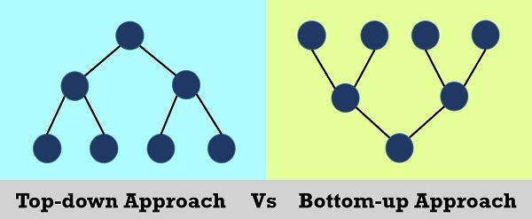

Slide 9
THANK YOU !

